Slide 1
Over-wintering honeybees

Slide 2
Adequate stores
> 20kg of honey
How to assess?
Frame | Cells (d*w) | Approx # cells in box | Honey content/frame
National super | 22*58 | 28000 | 1.0 kg
National brood | 41*58 | 52000 | 1.8 kg
14x12 brood | 60*58 | 76000 | 2.7 kg
Heroic assumptions made here – about extent of stores on a frame, spacing of frames and actual cell size. Let’s not debate the details, merely observe the trends

Slide 3
Bees are seasonal creatures
Winter
Preparations
Winter
Cluster
Re-build
Resources
Rapid Spring
Expansion
Colony
Reproduction
Notes:
Or, more strictly correct, COLONIES are seasonal creatures,
apart from the queen, no individual bee sees a complete seasonal cycle

Slide 4
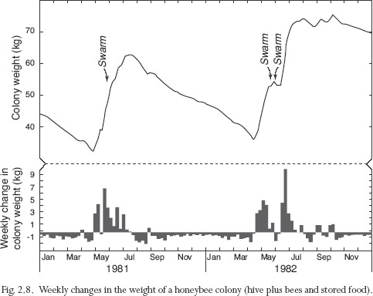
From early Sept to April, colony consumes stores
Mostly heating
Note increased use of stores in Sep, Feb, Mar
From Seeley, “Wisdom of the Hive”

Slide 5
Physiology of Colony Individuals
In late summer, egg-laying reduces drastically – in response to downturn in forage
Emerging bees no longer have a huge population of larvae to feed
This enables them to build up large reserves of “fat” inside their abdomens, via production of royal jelly in HPG
Winter bees (“diutinus bees”)
The Q lives even longer than winter bees
Life time of winter bee, emerging in Aug-Nov, is measured in months, not weeks

Slide 6
Adaptations
Summer bee Winter bee with fat deposits - Vitellogenin
There are striking differences in lifespan of bees in summer and winter
3-6 weeks in summer
>20 weeks in winter
Fat stores accumulate in the head and abdomen

Slide 7
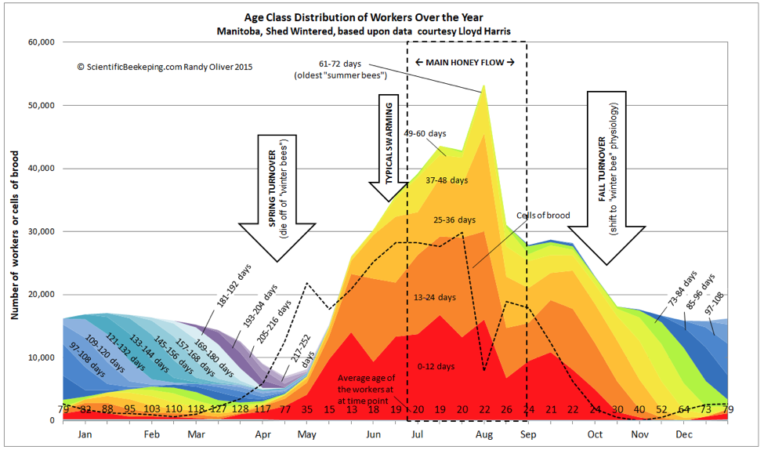
Population of workers and larvae
Notes:
https://scientificbeekeeping.com/understanding-colony-buildup-and-decline-part-3/#late-winter-broodrearing

Slide 8
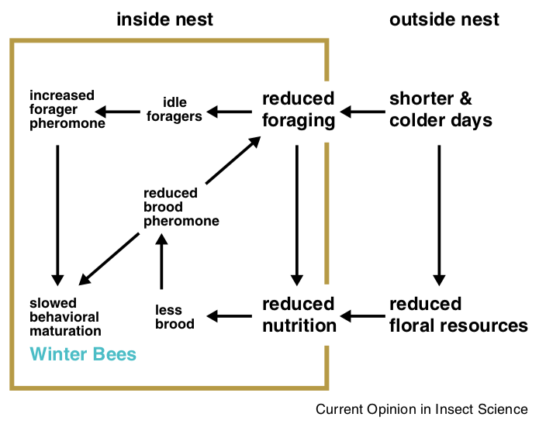
How do winter bees develop?
Notes:
DOI: 10.1016/j.cois.2015.05.014
Current Opinion in Insect Science
Volume 10, August 2015, Pages 185-193
Overwintering honey bees: biology and management
Mehmet Ali Döke, Maryann Frazier, Christina M Grozinger

Slide 9
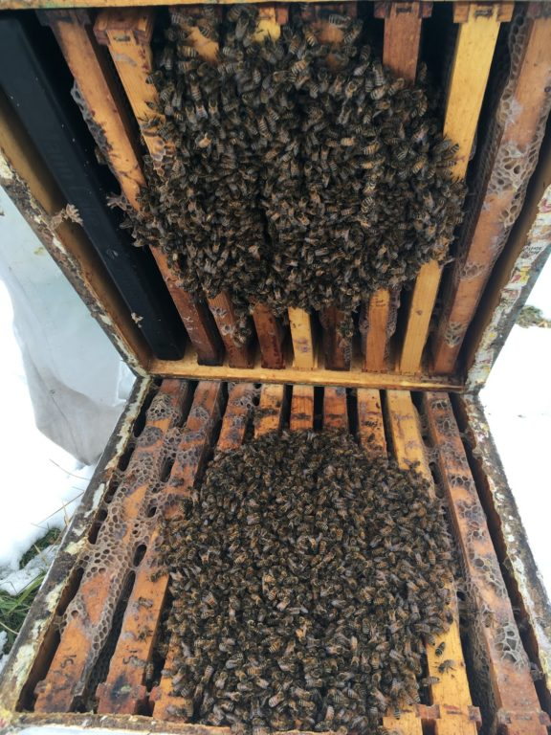
The winter cluster
Notes:
https://beeinformed.org/2020/05/13/feeding-time-frame-feeders/

Slide 10
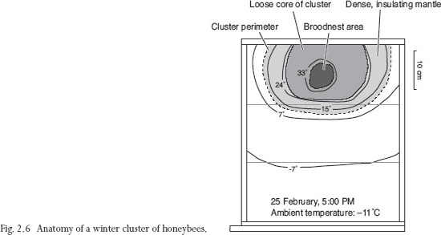

Slide 11
Temperatures and their effects on bees
Temperature | When observed
43 °C | Heater bees (brood nest, wax building), flight
35 °C | Brood raising, Muscle temperature for flight
20 °C | Centre of cluster without brood
18 °C | External temperature at which clustering starts
15 °C | Temperature at which cold torpor sets in for individuals
-5 °C | External temperature at which cluster is as tight as can be
-30 °C | Lowest winter temperatures in which bee clusters can survive

Slide 12
Spot the cluster

Slide 13
Cluster is like an old 20W lightbulb, glowing constantly

Slide 14
Thermal imaging of a frame in January

Slide 15
Only hot bees fly!

